Slide 1
Agile To DevOps overview
DevOps Quick Overview
Nicholas Rogoff
Cloud Solution Architect
Twitter: @nrogoff
Blog: https://blog.nicholasrogoff.com
25 June 2018

Slide 2

Take the DevOps pill

Slide 3

Traditional Development Process
Waterfall - One thing after another!
Requirements
Analysis & Design
Develop
Test
Maintain
Acceptance Testing
Unit Testing
Component Testing

Slide 4
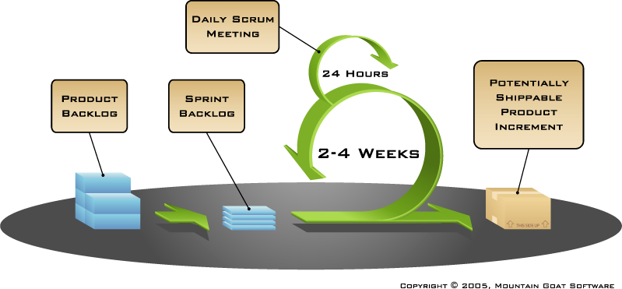
Agile Development Process
Quick Overview
Requirements
Analysis & Design
Develop
Test
Maintain
Notes:
Backlog
Prioritization
Sprints
Stand-ups
Potentially Shippable Products
Sprint Review
Sprint Retrospective

Slide 5
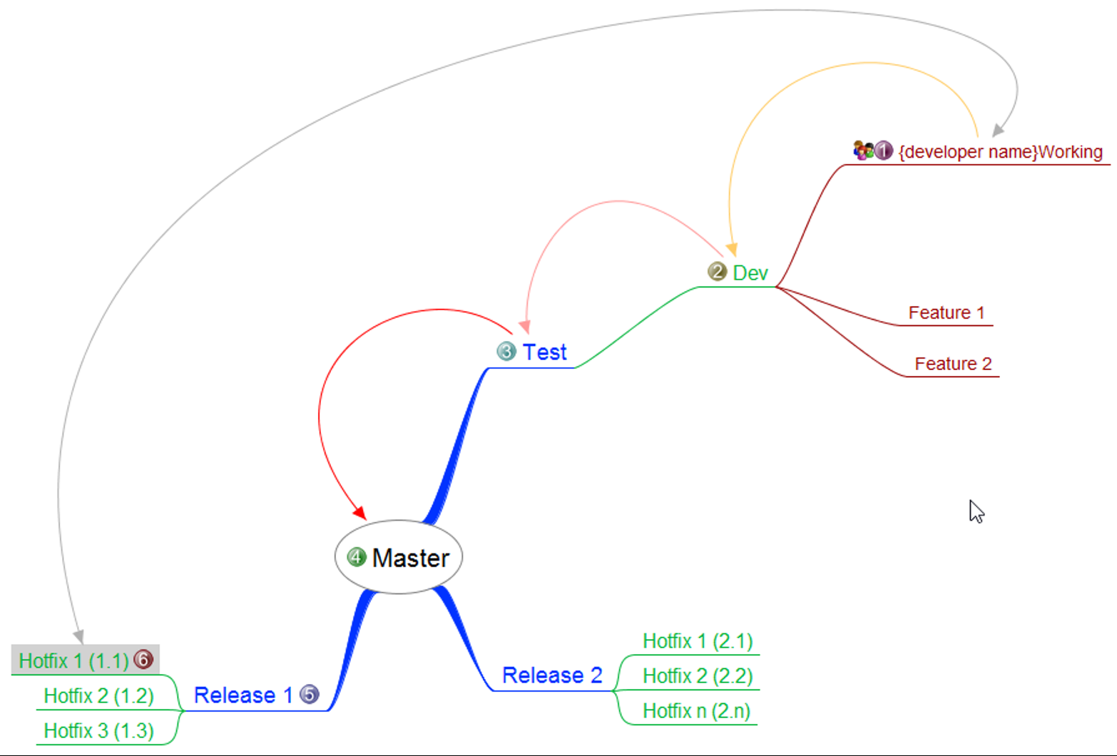
Continuous Integration (CI)
Branch, Build and Test Continuously
Code
Build
Integration Test
Merge
Unit Test
Deploy to Test
Notes:
Continuous Build
Continuous Unit Testing
Continuous Integration Testing

Slide 6
Continuous Delivery (CD)
Deploying Continuously
Code
Build
Integration Test
Merge
Unit Test
Deploy to Production
Deploy to Test
Deploy to Staging
Acceptance Test
Notes:
When passes CI
Min deploy to TEST
Preferably deploy direct to Production too
When we say deploy, this can include the servers and resources, especially in the new world of the Cloud.
Usually some approval workflow for the testers and delivery manager/operations teams

Slide 7
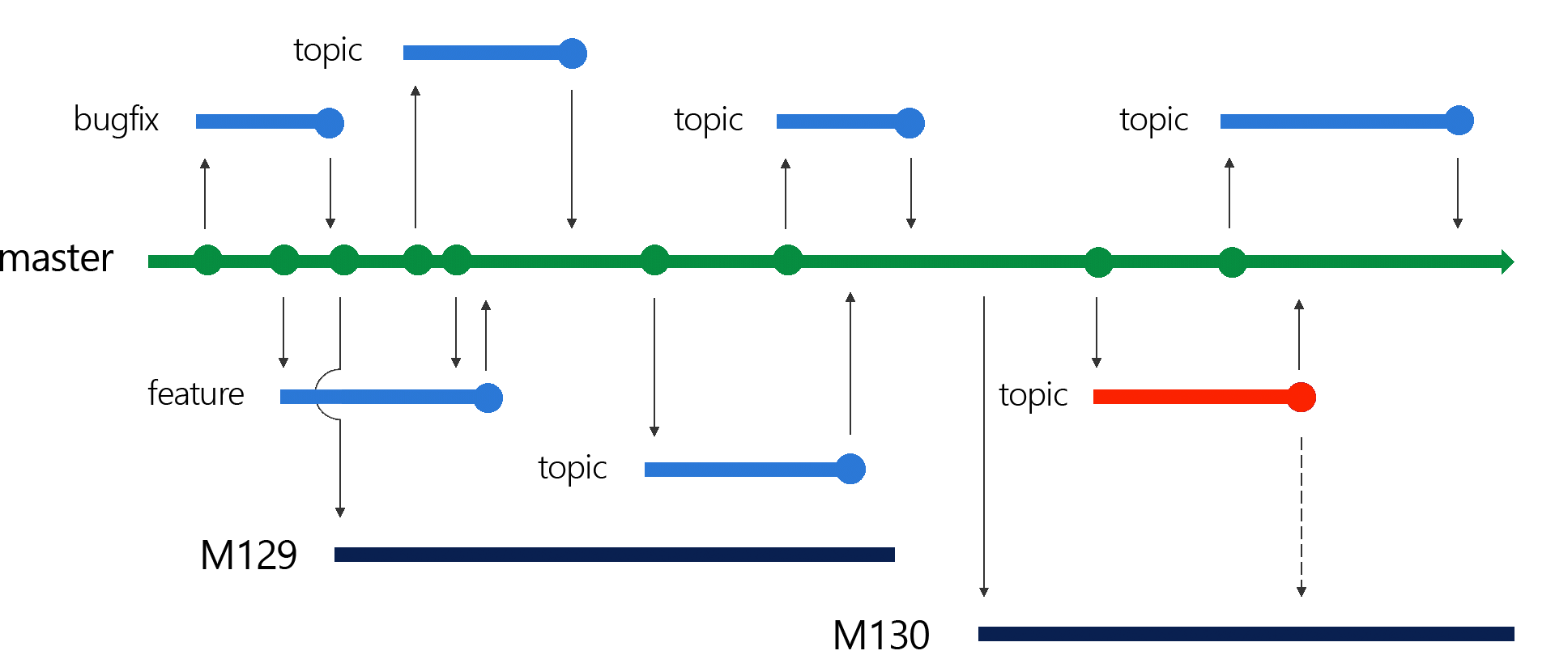
Trunk Based Branching
Create Topic or Feature branch from Master or Create Hotfix Branch from Release Branch
PRs Topic → Master → Release
Master CI\CD deploys to development environment
Releases branches CI\CD deploys to INT, STAGE and PROD
Notes:
Use Feature Flags: Rather than isolate feature code from other developer, keep the uncompleted features from the users

Slide 8
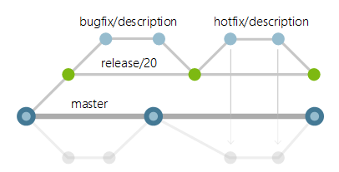
Trunk Based Branching – Multi-version
Notes:
This is a good strategy for products that may have multiple versions in production.
e.g. REST API’s

Slide 9
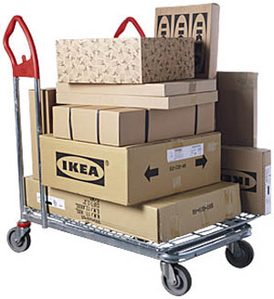
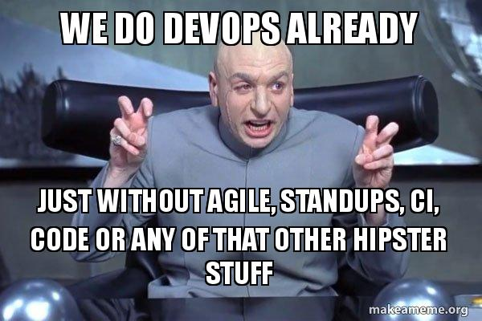

DevOps
Standard practice – Dev and Ops Silos
Notes:
Dev teams and operations teams team often have different values and ways of working and are often not in alignment
Code and artefacts delivered to Ops teams as scripts, binaries with instructions.
Production systems usually different, causes issues not yet experienced.

Slide 10
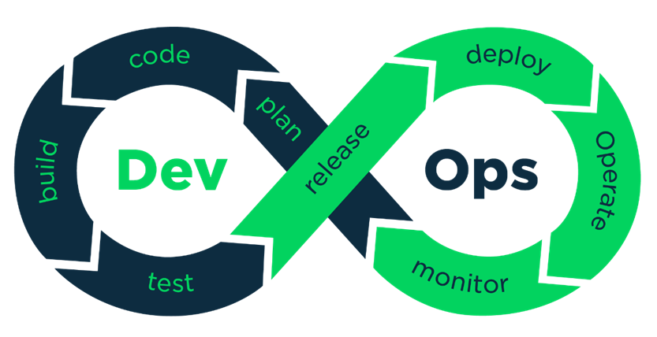

Slide 11
So What's DevOps?
Both an organisation’s culture and practice
The ​​​combination of culture, people, processes and tools to enable continuous delivery of applications and services of value at high velocity
OPERATIONS & MONITORING
RELEASE MANAGEMENT & GOVERNANCE
Delivery Approach & Methodology
QA & TESTING
BUILD MANAGEMENT & CI
DEPLOYMENT & PLATFORM PROVISIONING
*Sourced from Accenture’s DevOps Maturity Model © 2015 Accenture
Notes:
Being aware of the Dev and Operations from the start
Communicate and integrate operations within the full process
Under a DevOps model, development and operations teams are no longer “siloed.” Sometimes, these two teams are merged into a single team where the engineers work across the entire application lifecycle, from development and test to deployment to operations, and develop a range of skills not limited to a single function.
In some DevOps models, quality assurance and security teams may also become more tightly integrated with development and operations and throughout the application lifecycle. When security is the focus of everyone on a DevOps team, this is sometimes referred to as DevSecOps.
These teams use practices to automate processes that historically have been manual and slow. They use a technology stack and tooling which help them operate and evolve applications quickly and reliably. These tools also help engineers independently accomplish tasks (for example, deploying code or provisioning infrastructure) that normally would have required help from other teams, and this further increases a team’s velocity.

Slide 12
So What's DevOps?
The difference
Dev, Security, QA and Ops not ‘siloed’
Now one team
Multi-skilled members
Highly automated
Infrastructure as code
Full release management
Release approval workflow
OPERATIONS & MONITORING
RELEASE MANAGEMENT & GOVERNANCE
Delivery Approach & Methodology
QA & TESTING
BUILD MANAGEMENT & CI
DEPLOYMENT & PLATFORM PROVISIONING
*Sourced from Accenture’s DevOps Maturity Model © 2015 Accenture

Slide 13
DevOps and Modern Engineering
Components
DevOps Automation
Use your resources more efficiently while getting the most out of continuous feedback and collaboration
OPERATIONS & MONITORING
RELEASE MANAGEMENT & GOVERNANCE
Testing and QA Automation
Automating testing and QA assures faster delivery of higher quality product
Delivery Approach & Methodology
Systems Monitoring
Stay on top of your systems for better response times and quicker institutional learning
QA & TESTING
BUILD MANAGEMENT & CI
Service Management
Simplify IT support across the board and resolve issues before they turn into problems
DEPLOYMENT & PLATFORM PROVISIONING
Service Analytics
Better data means better results -- and support that improves over time
*Sourced from Accenture’s DevOps Maturity Model © 2015 Accenture
Notes:
Use your resources more efficiently while getting the most out of continuous feedback and collaboration

Slide 14
DevOps and Modern Engineering
Benefits
Faster time to value
Rapid Delivery
Reduce Testing Costs
Better Reliability
Reduced Risk
Easier Scaling
Improve Collaboration
Enhanced Security
Greater flexibility
OPERATIONS & MONITORING
RELEASE MANAGEMENT & GOVERNANCE
Delivery Approach & Methodology
QA & TESTING
BUILD MANAGEMENT & CI
DEPLOYMENT & PLATFORM PROVISIONING
*Sourced from Accenture’s DevOps Maturity Model © 2015 Accenture
Notes:
Use your resources more efficiently while getting the most out of continuous feedback and collaboration

Slide 15
Enable automated Self-Service Deployments
Fact – statistically no difference between Developers deploying code or Operations deploying code*
Mind shift to production deployments is needed
Development or Operations should perform code promotion processes
* Puppet Lab’s 2013 State of DevOps Report – 4000 professional surveyed

Slide 16
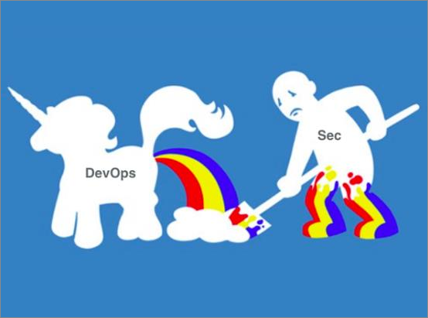
What about Security
DevSecOps

Slide 17
Amazon deploys NEW CODE to production every 11.6 seconds
Notes:
Operations velocity
https://www.youtube.com/watch?v=dxk8b9rSKOo

Slide 18
DevOps
Maturity
-1
0
1
2
3
AD-HOC
REPEATABLE
CONSISTENT
OPTIMIZED
LEADING
DELIVERY APPROACH | Release scope poorly defined; subject to catastrophic and ad hoc change requests | Releases duration exceeds business need; releases face disruptive change | Release cadences well defined but exceeds business need; Requirements are stable | Release on demand, multi-speed releases; time-box meets to business need (eg: monthly) | Small changes pushed through the pipeline; Continuous deployment enables innovation
RELEASE MANAGEMENT & GOVERNANCE | No defined or consistent applied delivery approach | Project based initiatives; no long term structure or responsibility | Industrialized project delivery; long term platform ownership | Platform based capacity delivery model – ownership of roadmap and CSI | Continuous Delivery / Deployment supporting agile business change
BUILD MANAGEMENT & CONTINUOUS INTEGRATION | No consistent use of version control – builds cannot be traced back to source code | Source code consistently managed in VCS; releases traceable to source | Developers integrate changes by checking into trunk on regular basis (daily) | Build is typically green – if build breaks developers do not make other changes until resolved | Build is typically green – if build breaks the CI tooling automatically reverses the failed change
DEPLOYMENT & PLATFORM PROVISIONING | Mostly manual deployments | Some CIs automated, environment tailoring required, no enterprise tools | Fully automated Single-touch deployments into environments | Functioning environments can be build from nothing programmatically | Zero-touch zero- downtime deployments OR Platform (PaaS) used
CONTINUOUS DELIVERY – QA & TESTING | Fully manual test scripts | Testers run a harness / suite | Test harness / suite run automatically for some environments | Automated test suites enforce a quality gate | Tests run as functional monitoring
OPERATIONS & MONITORING | No monitoring tools | Tools in place, but not configured beyond basic OS checks | Configured by a tool and role specific checks added | Environment and application health monitored and proactively managed | Service level monitoring (perf, usage) integrated with infrastructure
PLATFORM | Servers created on ad-hoc basis; no defined standards or platform | Servers created by hand, but to defined standard | Servers provisioned on demand (e.g. Via a portal) | Servers created programmatically; all maintenance automated | Services distributed automatically with auto-corrective mechanisms in place
Sourced from Accenture’s DevOps Maturity Model © 2015 Accenture & Avanade Inc.
All Rights Reserved.
4
Notes:
https://devopsassessment.net/

Slide 19
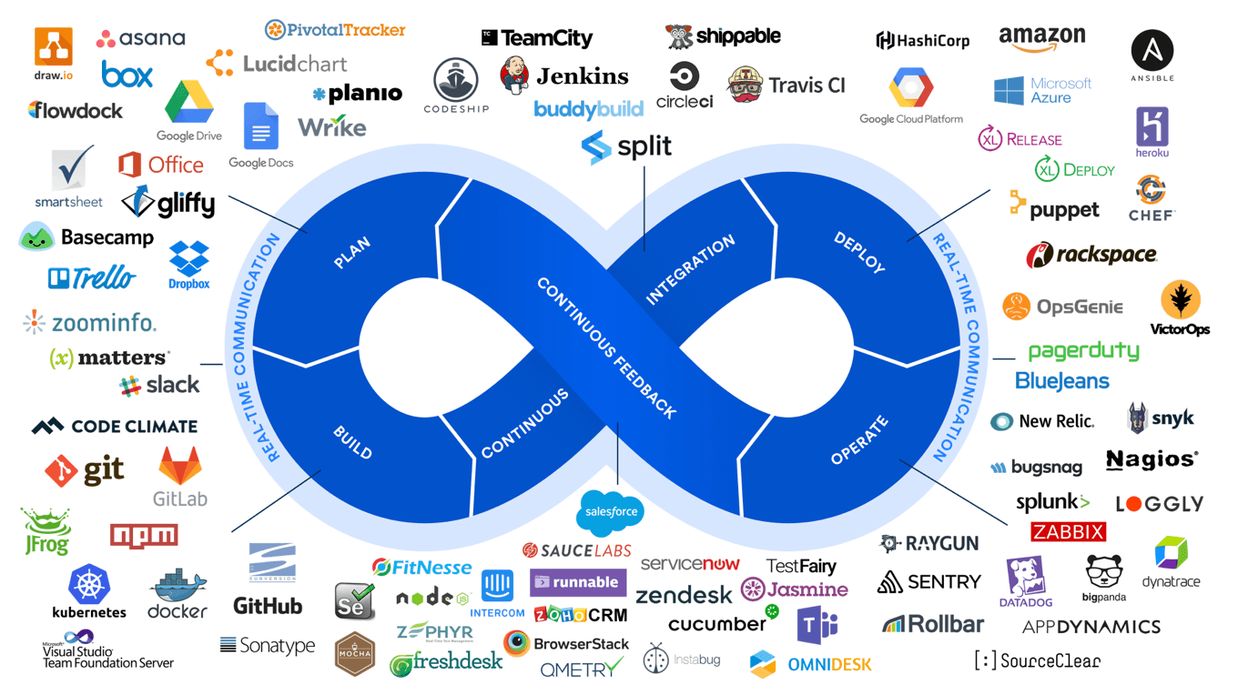
DevOps
DevOps Landscape!!

Slide 20
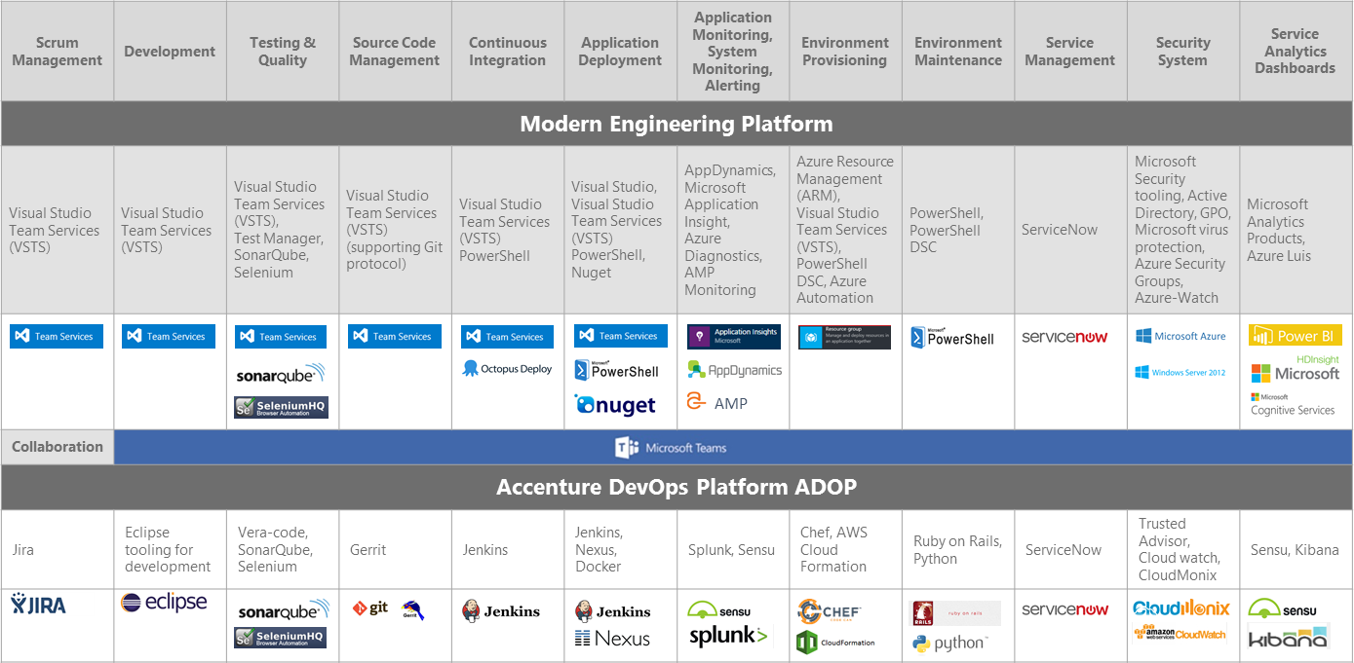
DevOps
Modern Engineering

Slide 21
Accenture DevOps practices
Five fundamental practices enable optimized delivery of IT solutions
Automated Operations Environment Configuration, Monitoring, Incident Management, Environment management
Automated Release of Software Automation of Build & Deploy Process, Application Asset Management, Software Configuration Management (SCM)
Continuous Integration Advanced SCM concepts, Automated Unit Testing, Static Code Analysis, Automated Build & Deploy Process
Continuous Delivery Pipelines (Incl. Automated QA) Orchestration and automation of all SDLC processes
Software Defined Infrastructure & Cloud Automated creation of environment, Dynamic scaling, drift detection and remediation

